Slide 1



Machine Learning Models To Predict Future Stock Movement
Alpa Sheladia
Will Turner

Slide 2

Algorithmic Trading
Objective:
Using NLP / Logistic Regression to Predict Future Stock Movement
Program that allows a user to choose a stock from the S&P 500 or VIX run a logistic regression model to predict the price movement of this stock ‘s on the future trade based on current sentiments of Reuters news articles and social media post related to that organization.
This platform performs data training using various models to provide best analysis to help traders decide whether to buy or sell the stock.

Slide 3








Data Collections
VIX (Chicago Board Options Exchange ) , SPY S&P500 (The SPDR S&P 500 Trust ETF ), news Articles from NewsAPI, and Tweets from twitter API

Slide 4
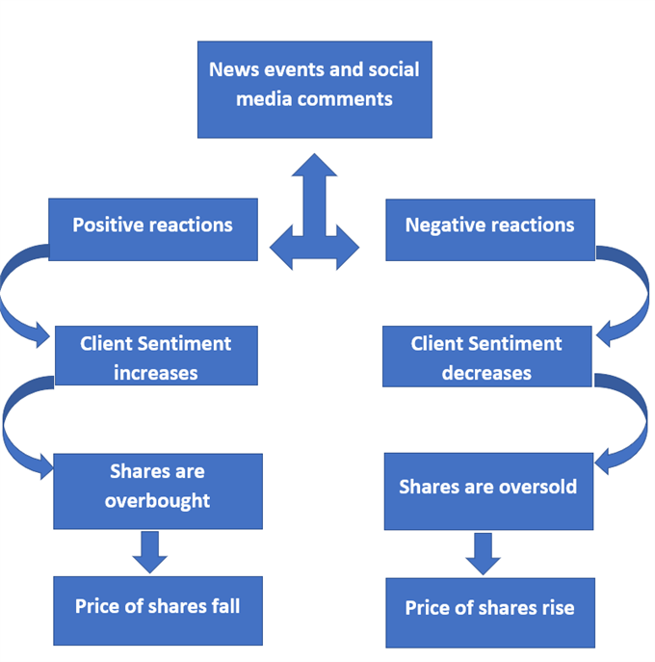
Notes:
This shows how sentiments analysis is normally used in analyzing stock and how positive and negative context can have and the influence certain information can have on an acquision.

Slide 5
Multi Model Utilization for Time Series Prediction ( SPY & VIX)
Load Data.
Define Models.
Compile Keras Model.
Fit Keras Model.
Evaluate Keras Model.
Tie It All Together.
Make Predictions
Tune the Model
Save the Model
Summarize the Model
Separate Train and Test Datasets
Plot Learning Curves
Learn a New Dataset
Use Functional API

Slide 6
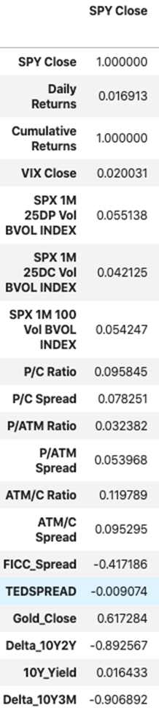
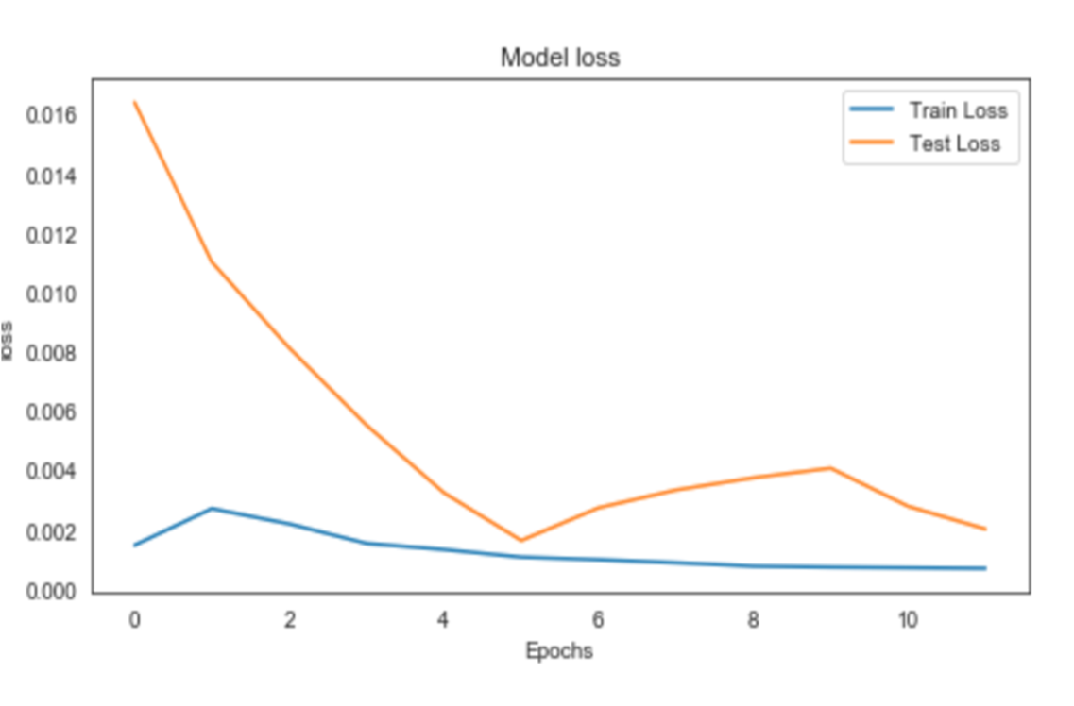
Overfitting/Underfitting Goldilocks Model

Slide 7
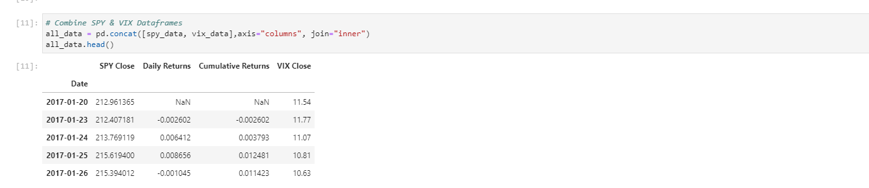
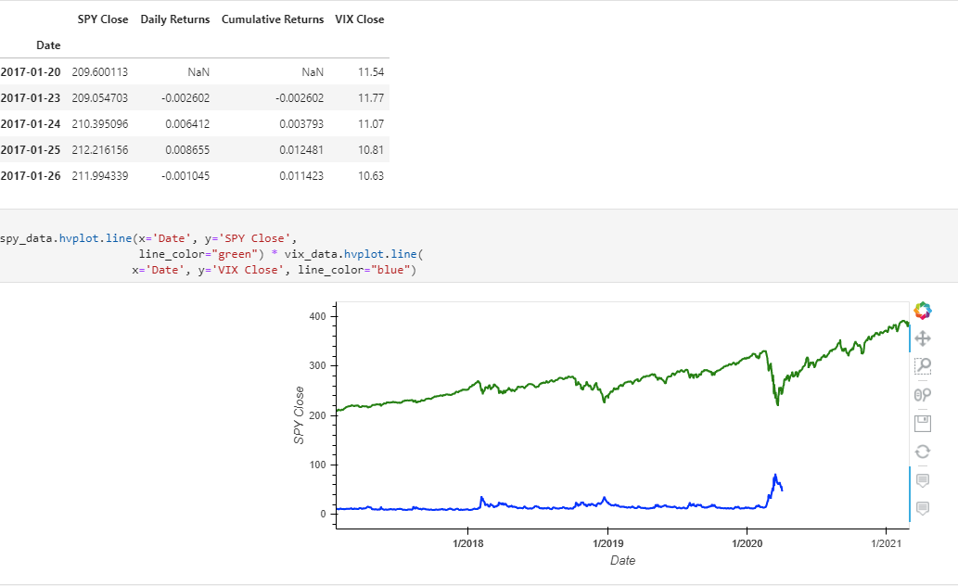
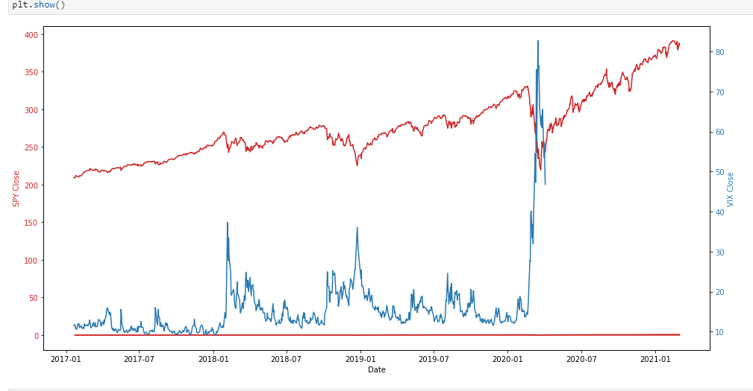
SPY and VIX Data Visualization
Overlay Chart of SPY and VIX
Closing data of SPY vs. VIX

Slide 8
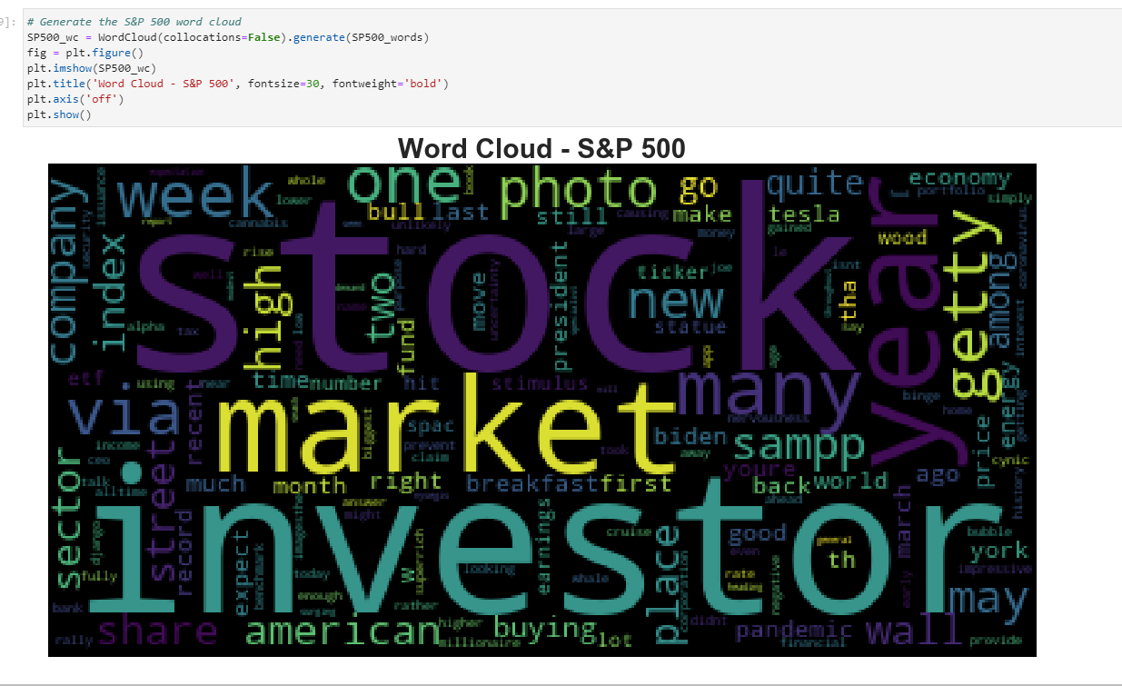
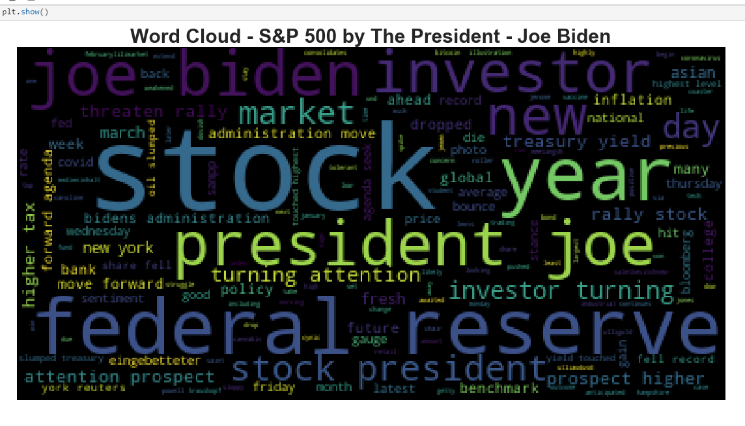
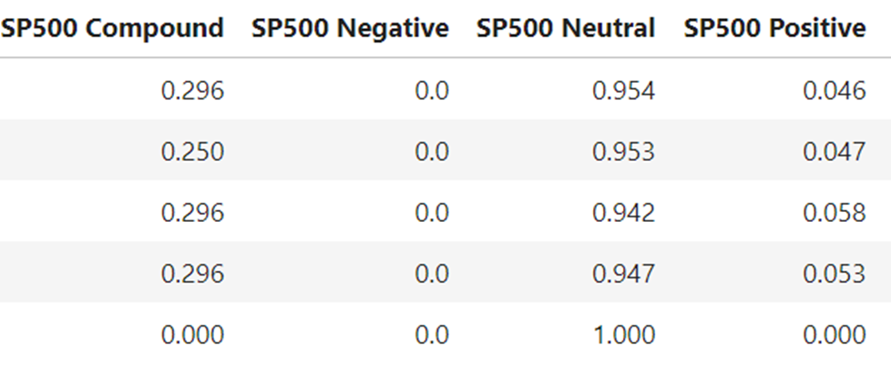
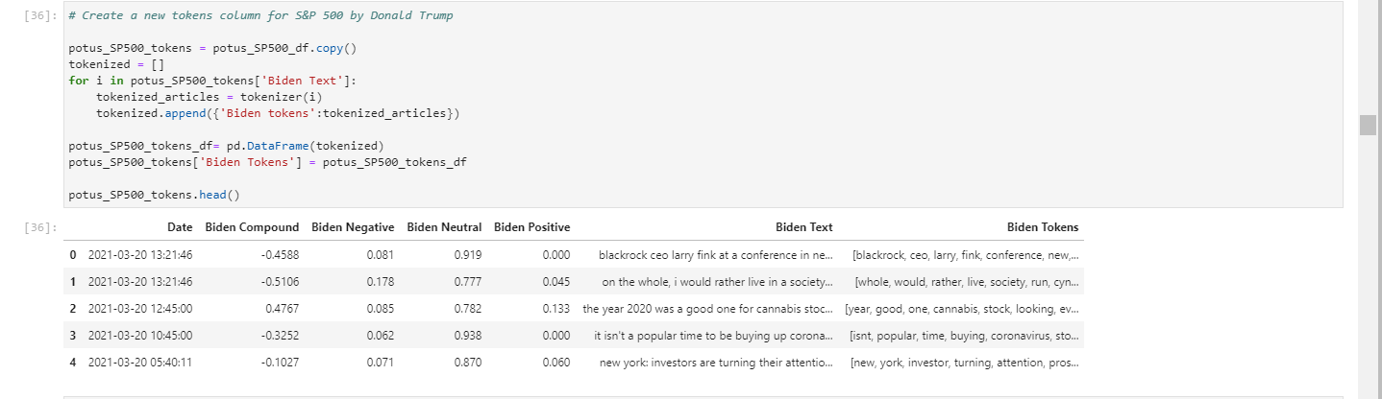
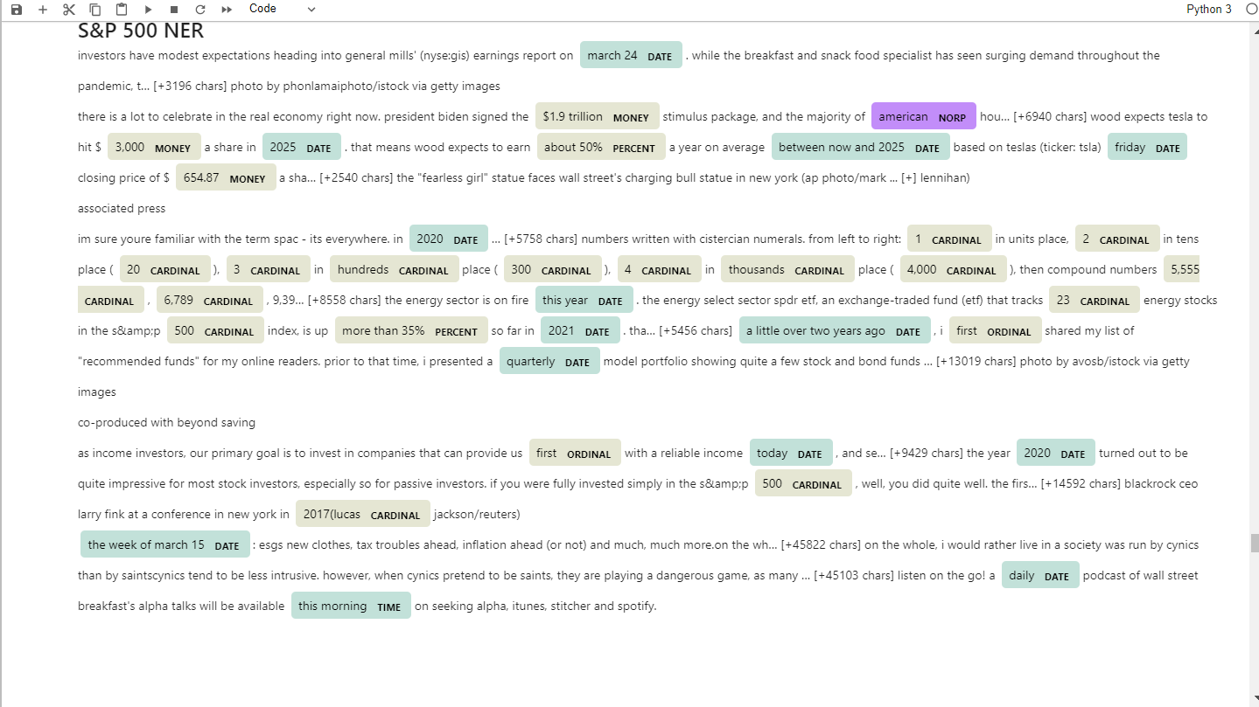
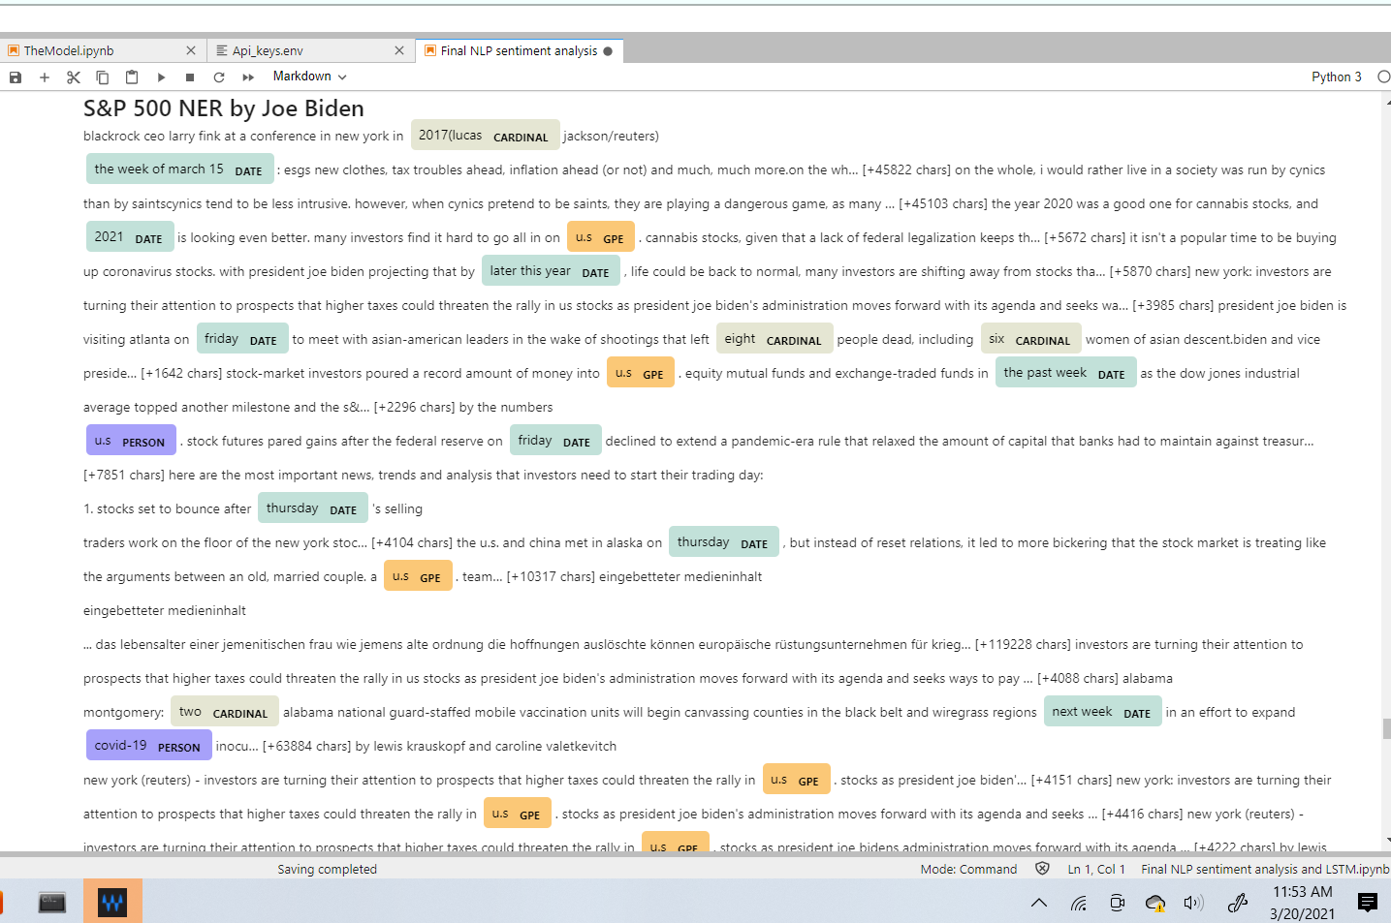
Slide 27
Sentiment Analysis
Word Cloud S&P 500
Word Cloud President Joe Biden

Slide 9
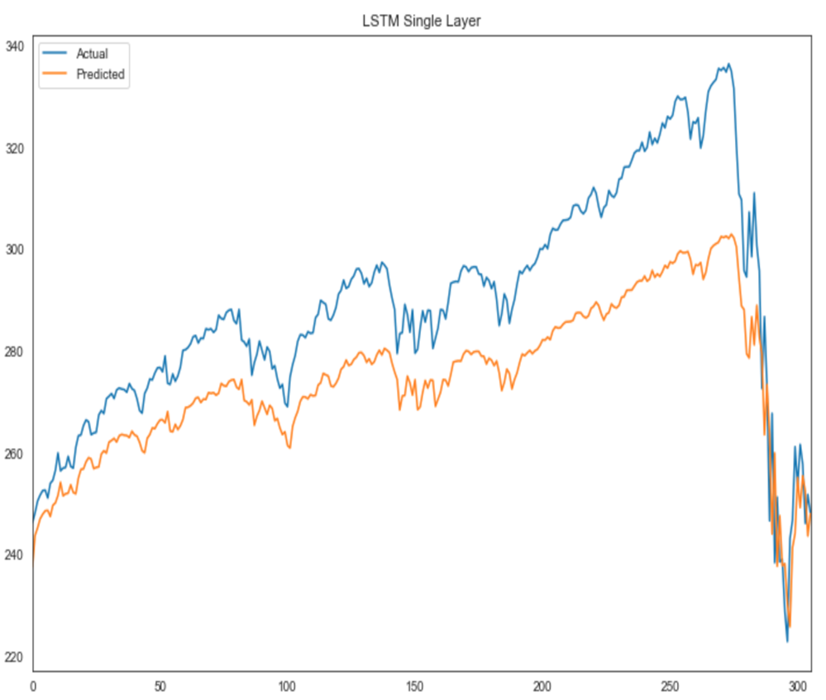
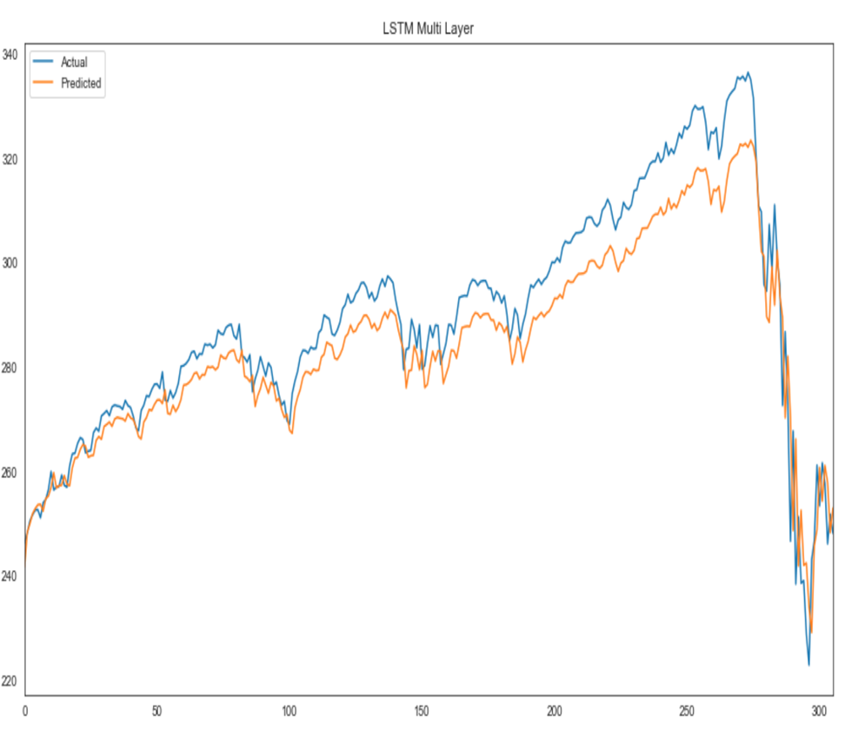
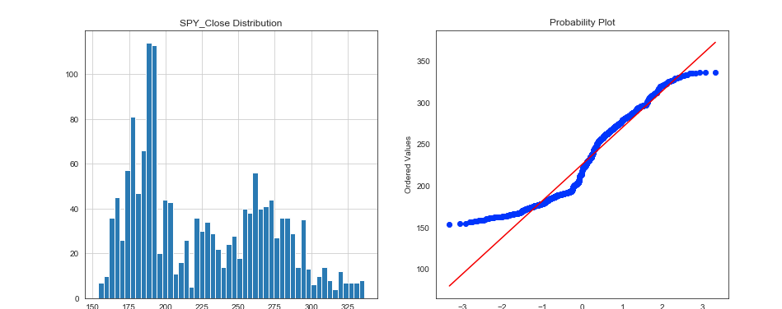
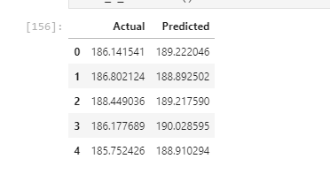
Single Layer – LTSM
Multi- Layer - LTSM

Slide 10
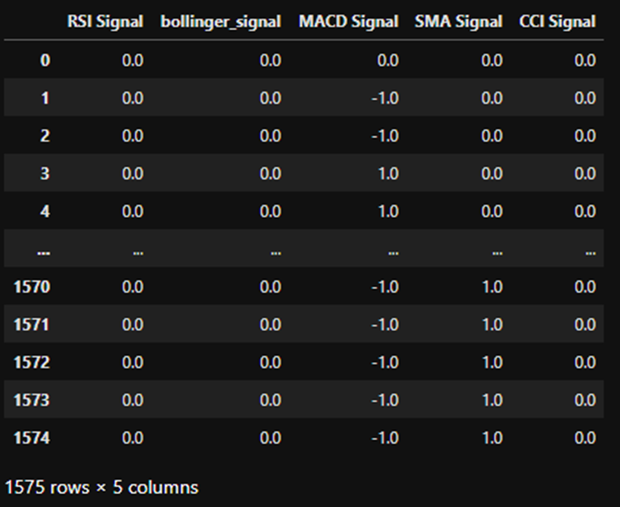
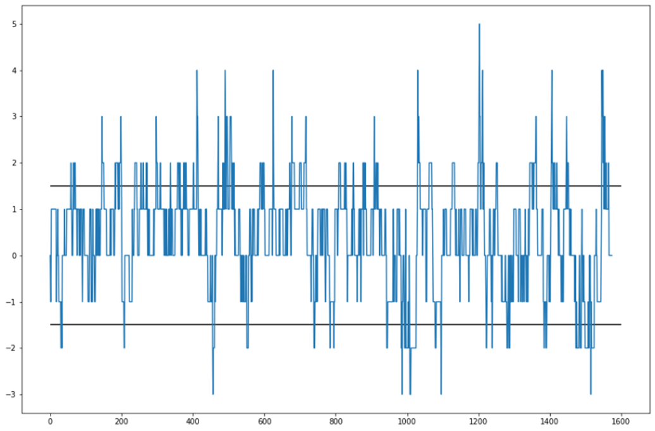
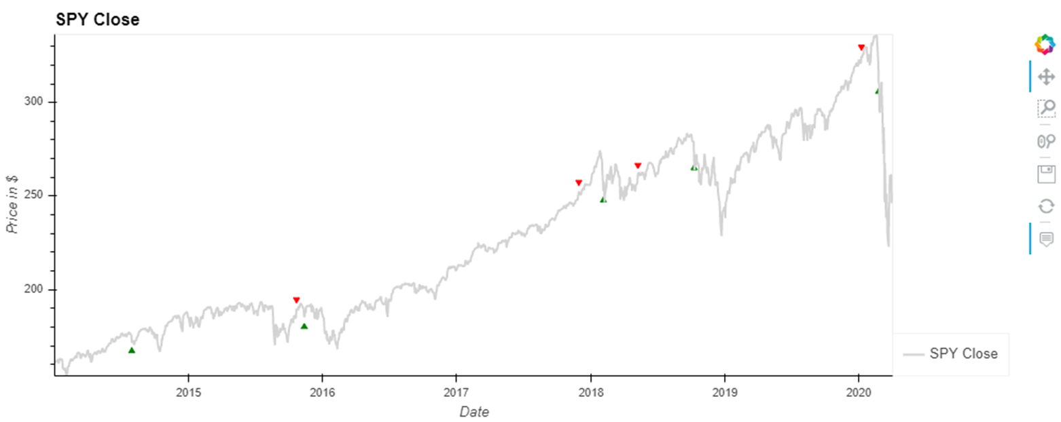
Trading Signals as Input Data
Signals
Generating Signals
Buy/Sells

Slide 11
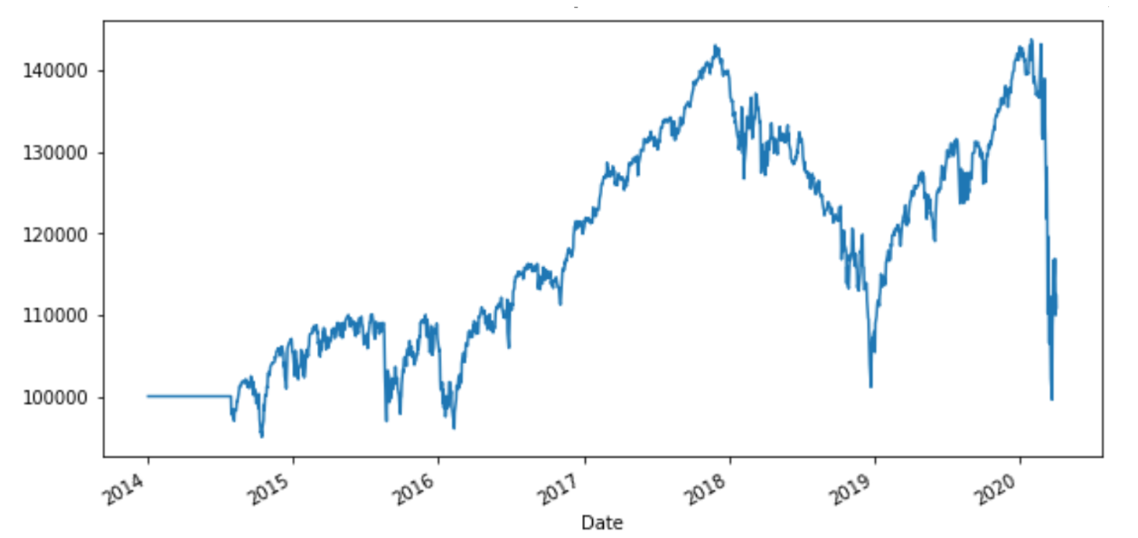
Profit & Loss

Slide 12
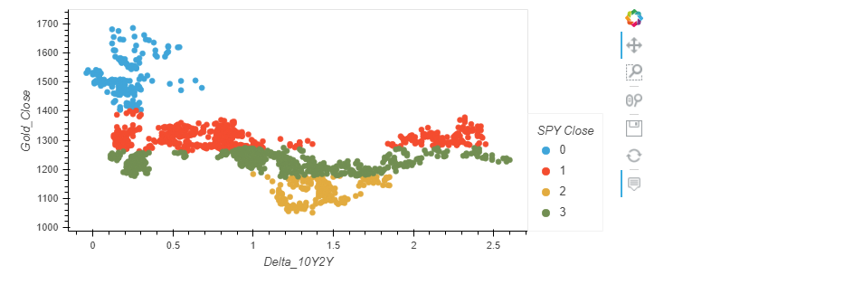
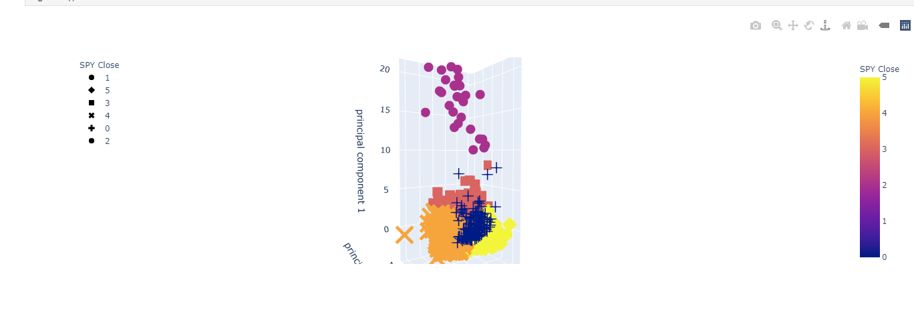
K-means and Initialized 3D-Kmean

Slide 13
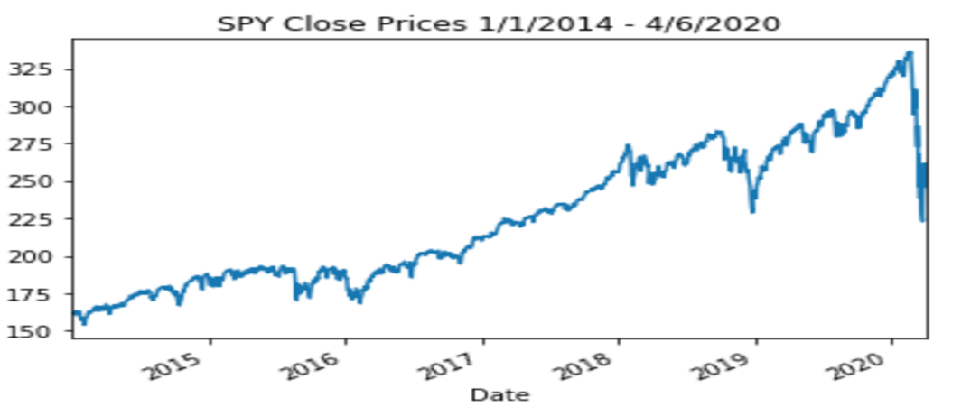
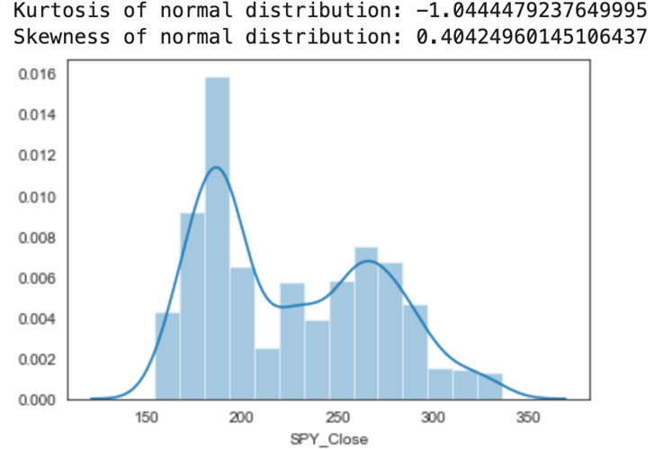
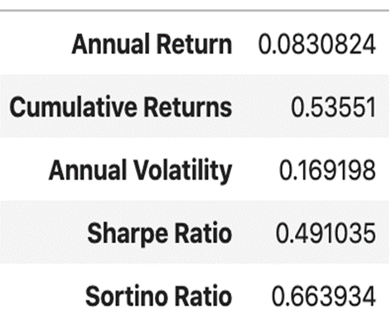
Visualizing S&P 500

Slide 14
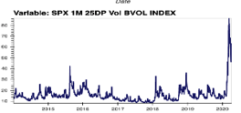
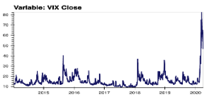
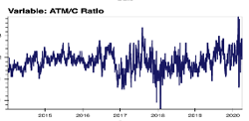
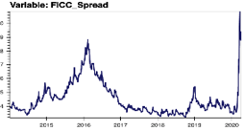
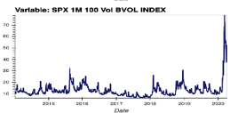
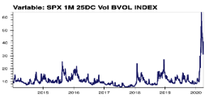
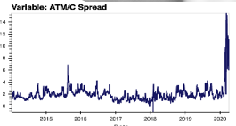
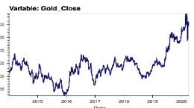
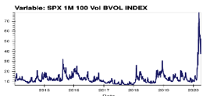
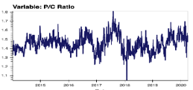
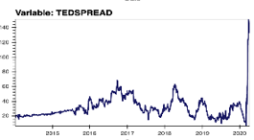
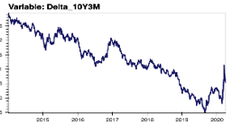
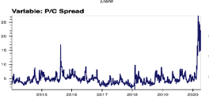
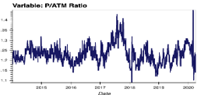
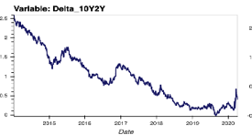
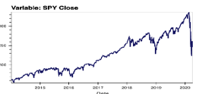
Economic Data

Slide 15
Final Output
User will see reliable accurate information regarding the acquisition of stock and use the data to determine whether a user should buy or sell stocks or simply hold on to them for now.
We used several features and academic research to figure out that media plays crucial role in market volatility. We redefine sentiment and multivariate to extract data from news articles to see the affect on future prices of stocks
News Media and Social Media’s influence: Extreme events let to biased and unbiased media coverage which affects stock prices based on the financial sentiment analysis.
This is supervised learning task since the data is provided with target variable is next day's price . Data features include parameters, prices,VIX, Sentiment, Closing Price and Volume
In deep learning, a convolutional neural network is a class of deep neural networks, most commonly applied to analyzing visual imagery. They are also known as shift invariant or space invariant artificial neural networks, based on their shared-weights architecture and translation invariance characteristics. We repurposed it to multivarious signal to get readable result in order to incorporate the information from all features and identifies the features significant to predict the price for the next day

Slide 16
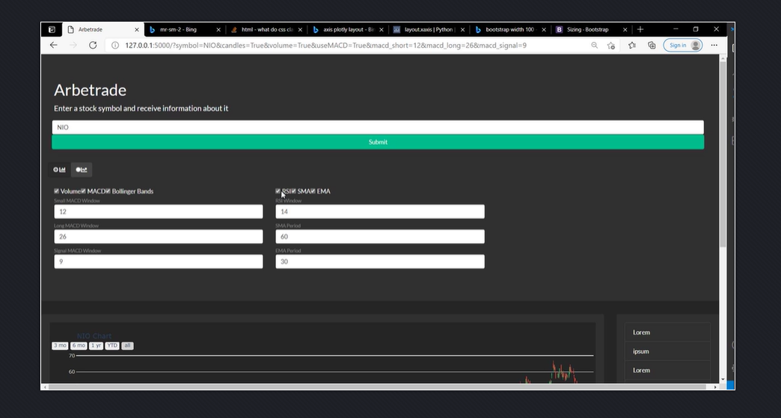
FrontEnd
Notes:
We created html userfriendly front-end

Slide 17
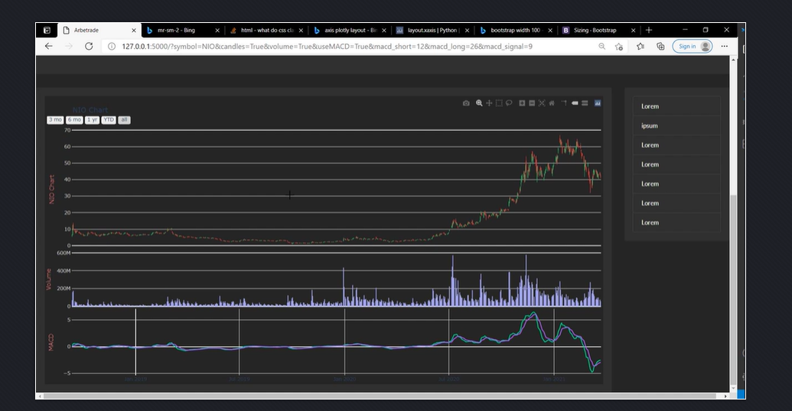
Notes:
Our Front-end provides detailed analysis of stocks of your choice with visuals for better understanding.

Slide 18

Any Questions?

Slide 19


Thank You

